Slide 1


Be committed to college student rental services
Date：2019.6.6

Slide 2
Group
shadowrocket
Group/member
William
Caden
Palmer
Guy
Chanller
Jay

Slide 3

Our program： Sias Rental Platform
Our program is to provide students with a good platform for product rental information exchange, to help them solve the problem of accumulating idle products in their hands, and to enjoy life without spending a lot of money. There are a lot of websites available for renting goods, but there are few websites for college students to rent products in Sias

Slide 4
What are the functions of our program?
Manage personal information
Publish goods
Delete/Modify product
Search and view goods
Favorite Product
Settle in the shopping cart
Comments
View order status
Evaluation product

Slide 5
Function: Registration
Palmer

Slide 6
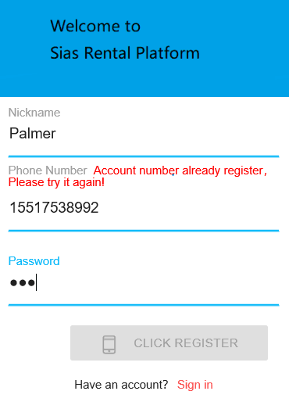
Function: Registration
When registering a new user, the system will automatically compare the information entered by the user with the existing database, check whether the user name, mobile phone number and other information is repeated, if repeated, refuse to register, and remind the user to change the registration information

Slide 7
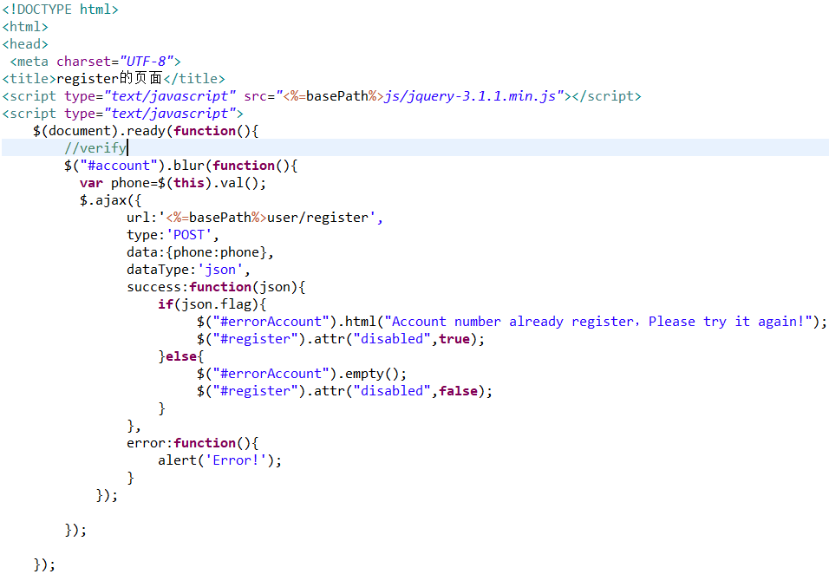
This part of code is the system automatically detects the user registration information.

Slide 8
Function: MD5 Encryption
William

Slide 9
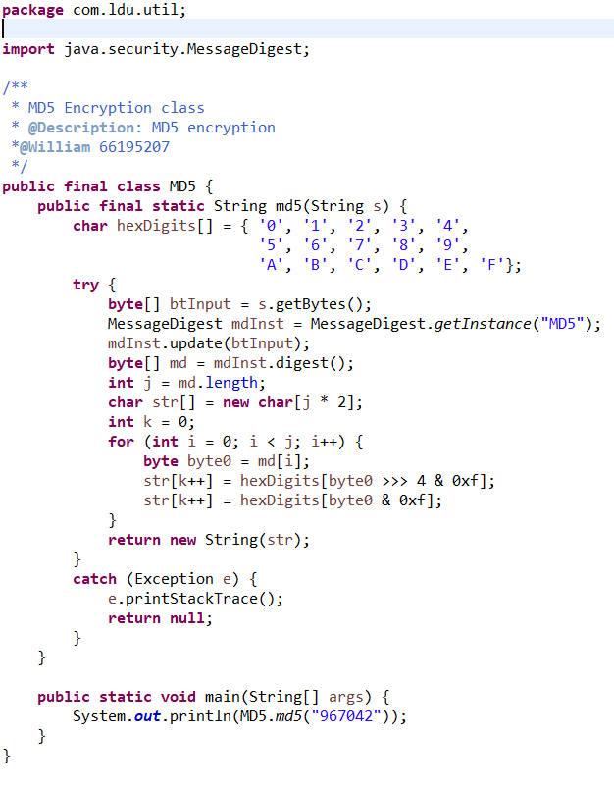
Function:MD5 Encryption
Md5 class
As a service provider, the security of the user's personal information is very important to us. We use the MD5 encryption algorithm to save the user's password. During the encryption process, the user's password will be generated by a specific algorithm to generate a fixed length MD5 encrypted string. And this encryption process is almost irreversible, and it is fully automated, so it can fully protect user password security issues.

Slide 10
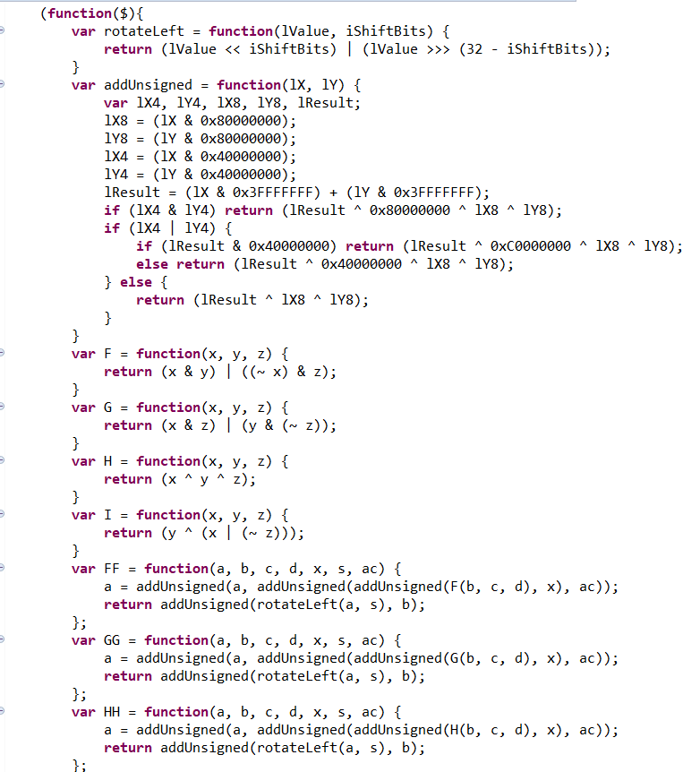
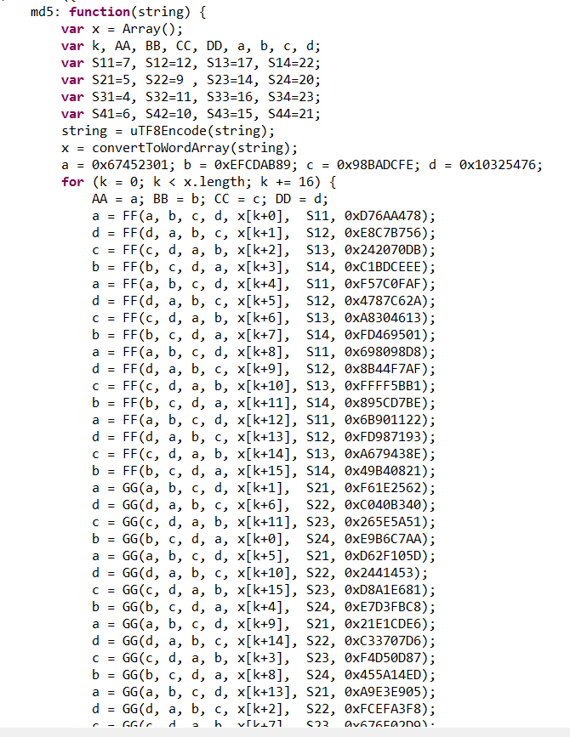
Function:MD5 Encryption
Md5 class

Slide 11
Function: Publish goods
Caden

Slide 12
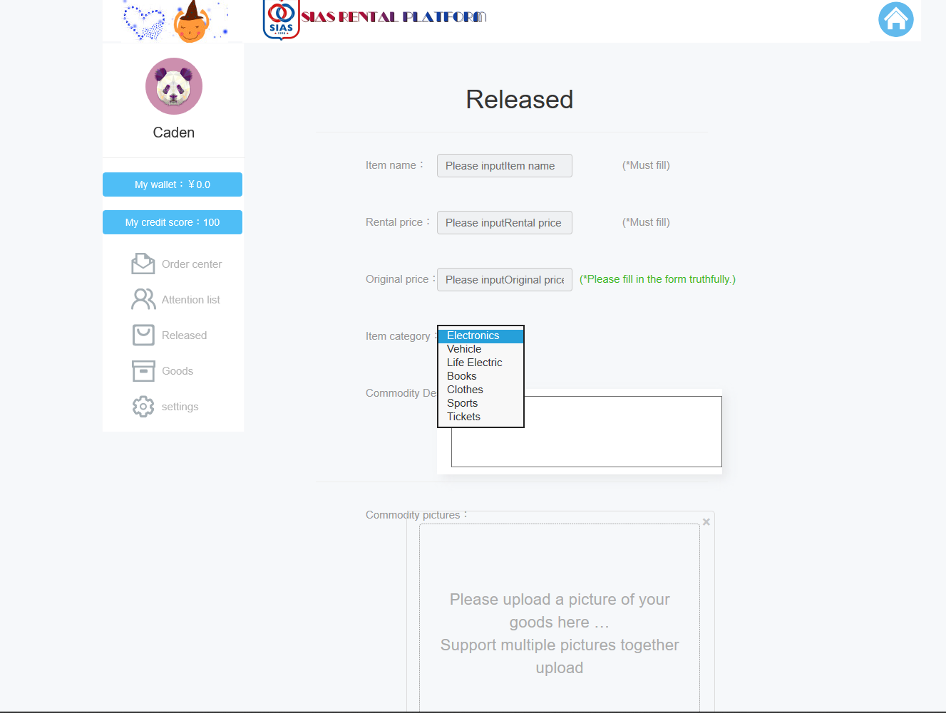
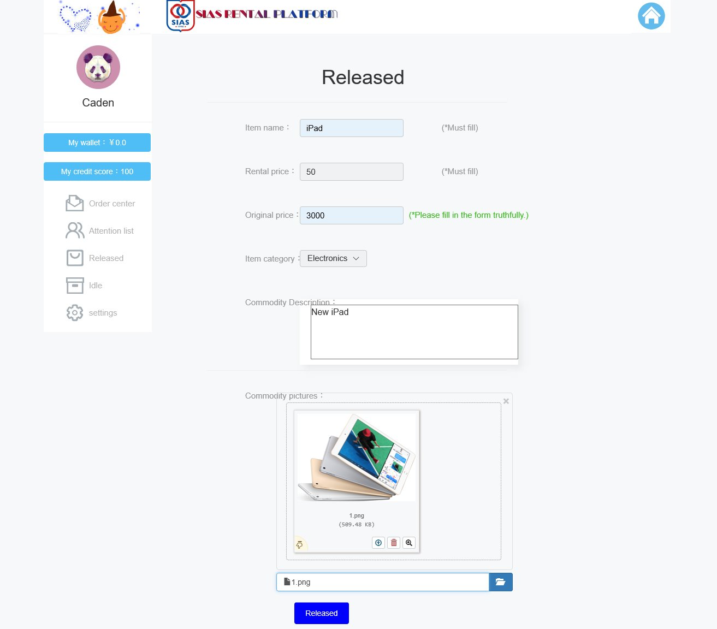
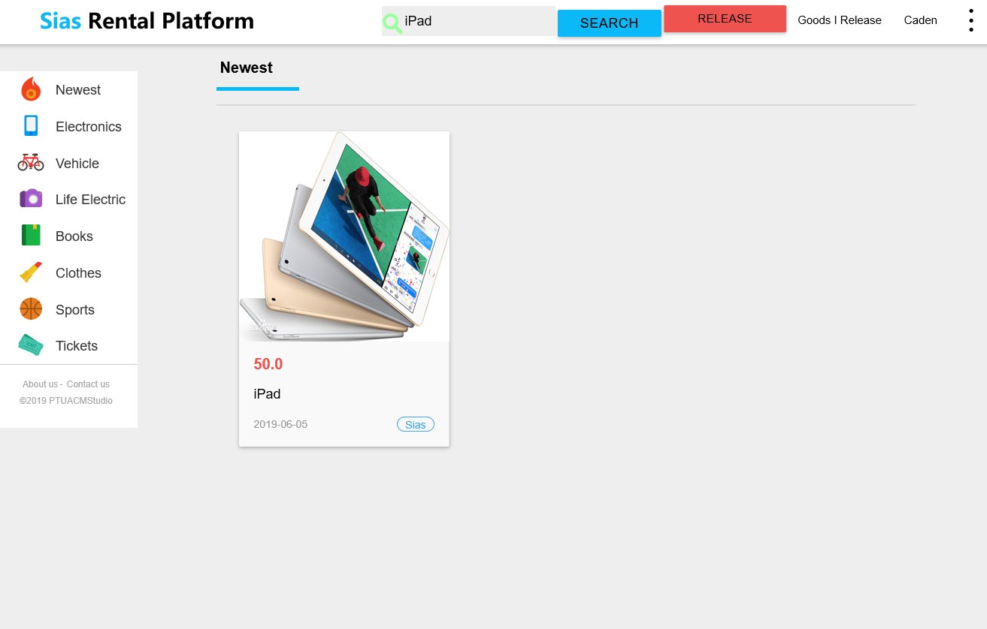
Function: Publish goods
1
Enter the product release management interface
2
Input information about the goods
3
Search for goods and view，Successfully released

Slide 13
Automation
When the user fills in the information, the system will automatically detect what information the user has not entered, and determine whether the information is in the correct format.
When the user fills in the information, the system will automatically detect what information the user has not entered, and determine whether the information is in the correct format.
When uploading an image, the system will detect the size of the image. If it doesn't match, it won't upload, and it can also upload multiple images together.

Slide 14
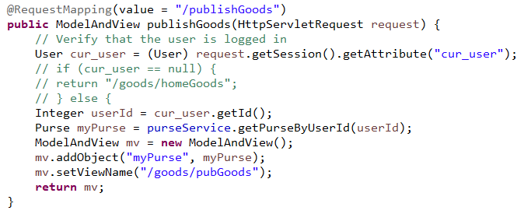
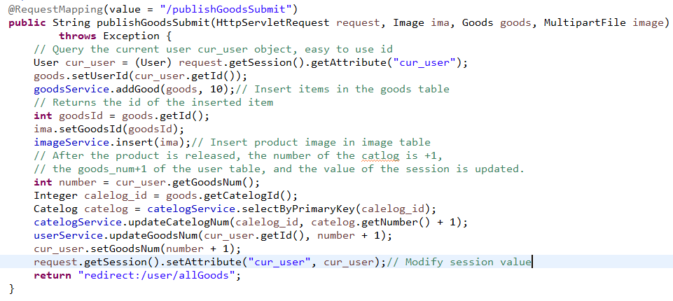

Slide 15
Function: Search and view goods
Jay

Slide 16
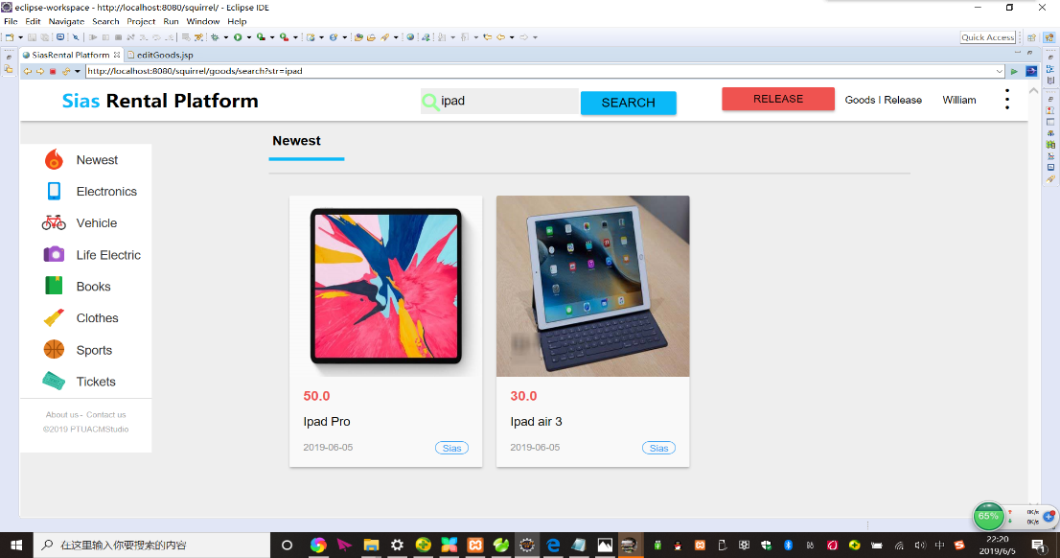
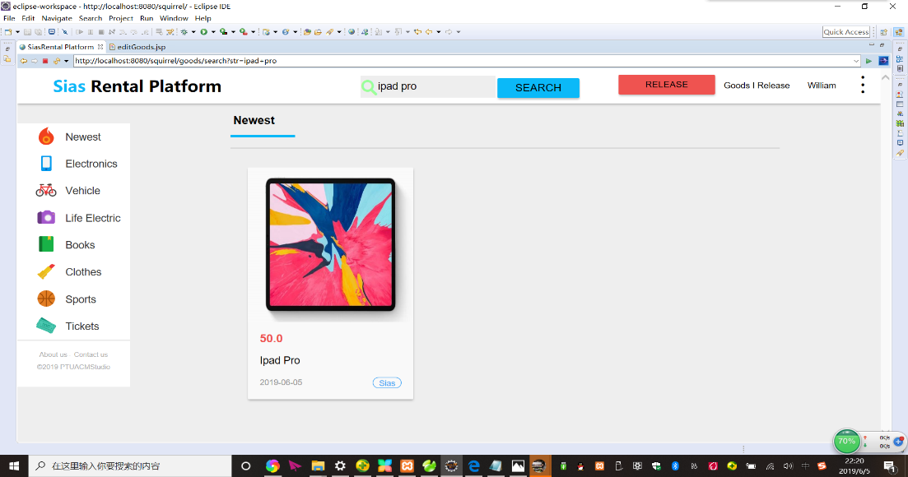
Function: Search and view goods
What will be described is a search process where the user can perform an accurate search as needed. The user only needs to enter the exact product name, and the background will perform an accurate search in the database. For example, if you search for paid, all items will appear, but if you search for paid pro, all paid pro items will appear.

Slide 17
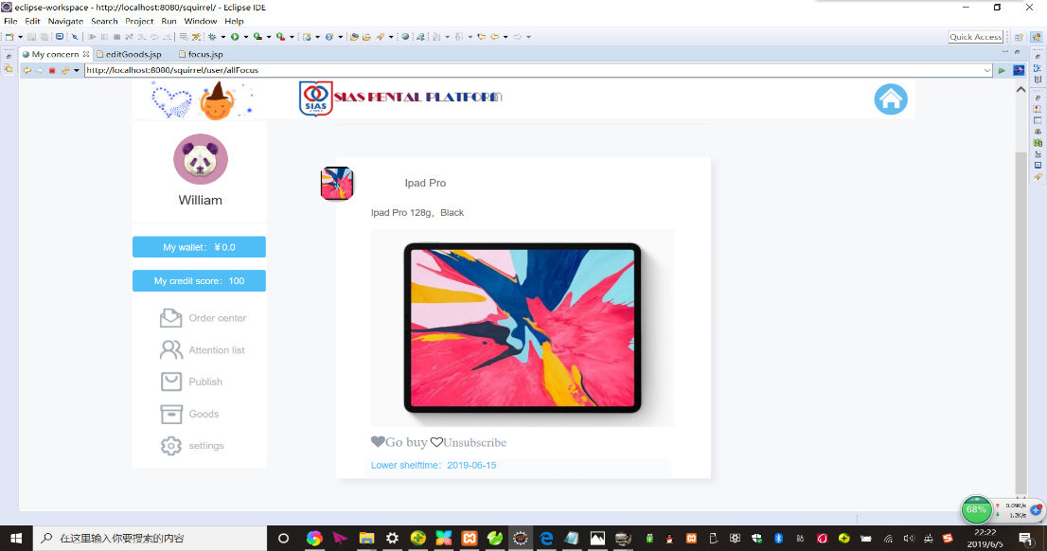
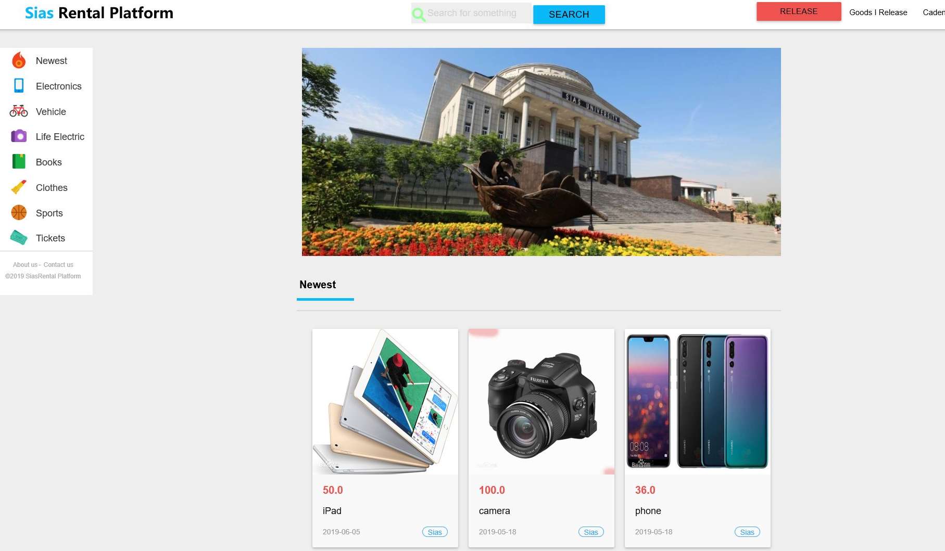
Function: Add attention
When you search for the item you want, you can click on the collection to quickly find it, and the background will send the item directly to the user's favorites. Recommend more items you might like on the homepage.

Slide 18
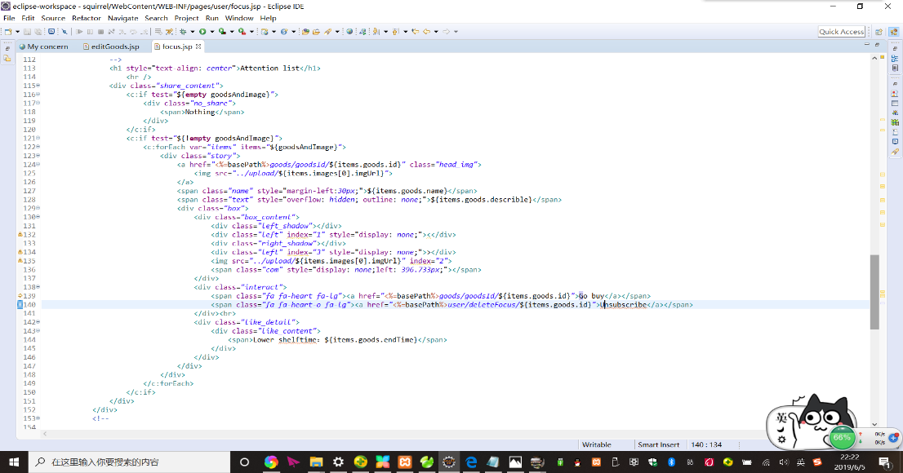

Slide 19
Orders Controller
Chanller

Slide 20
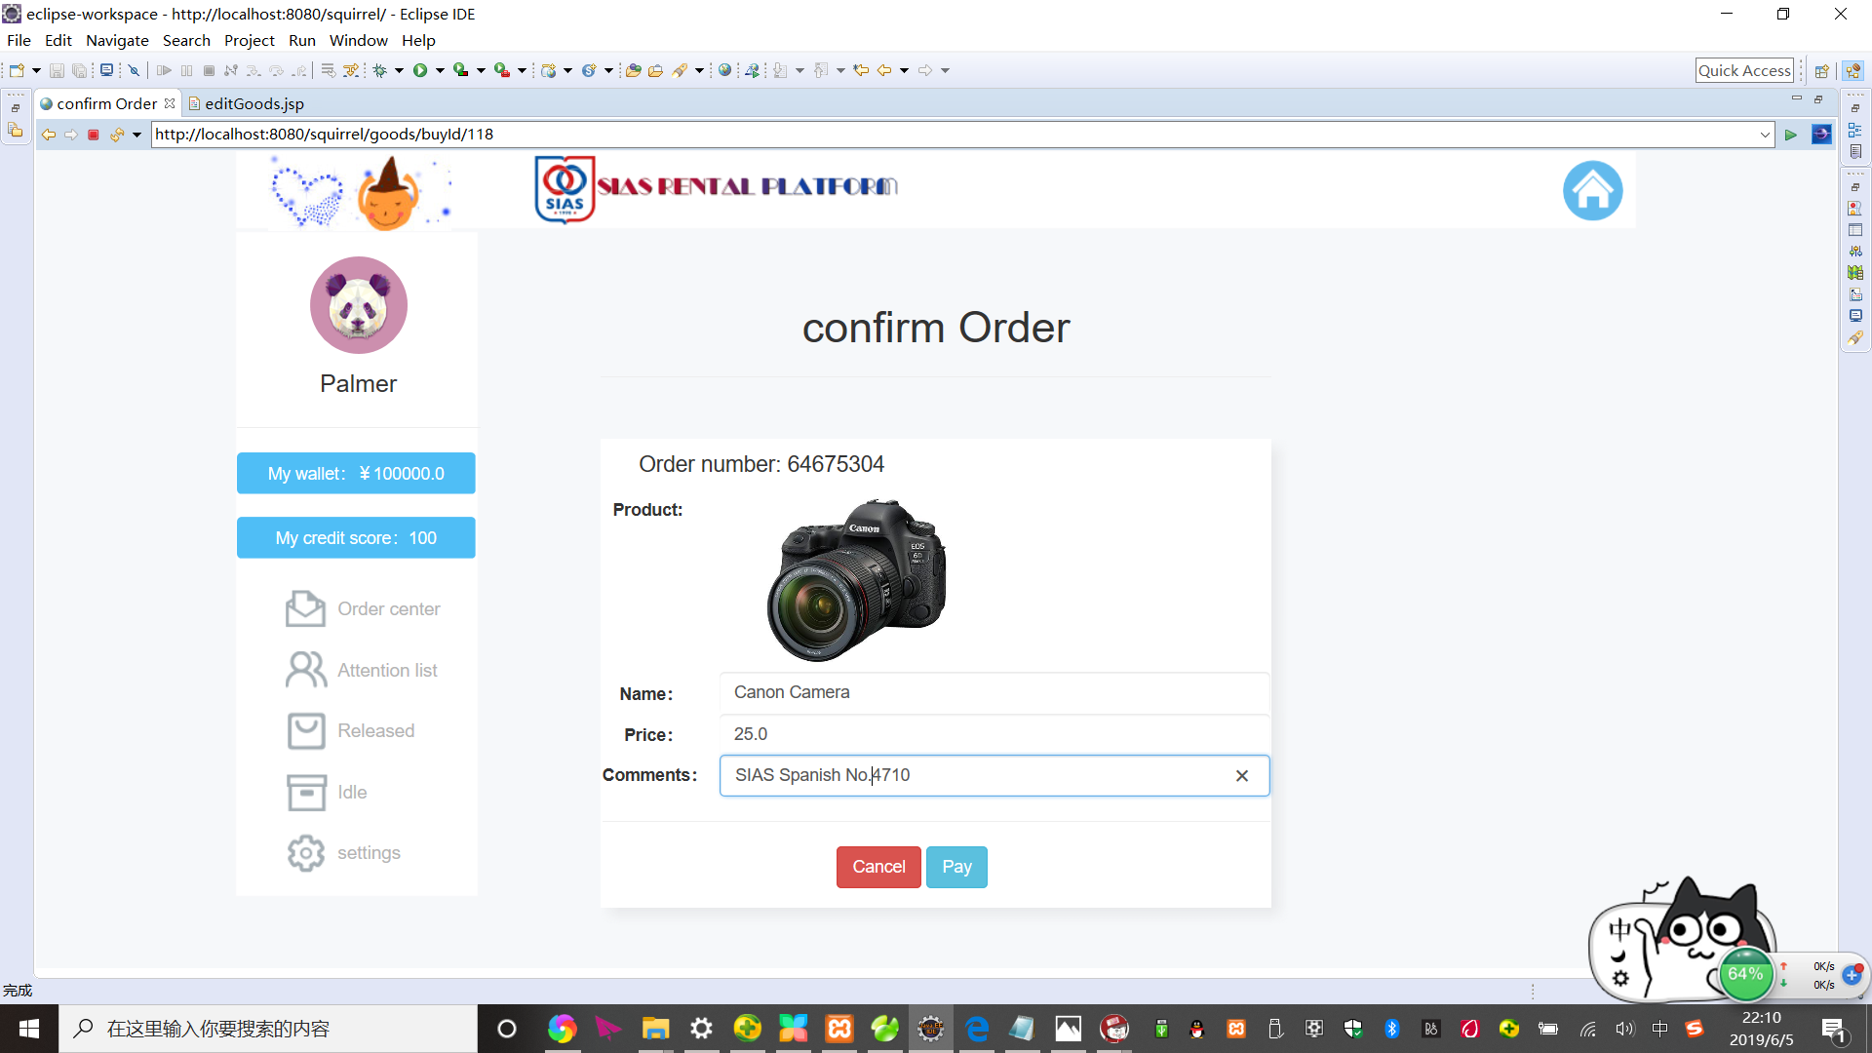
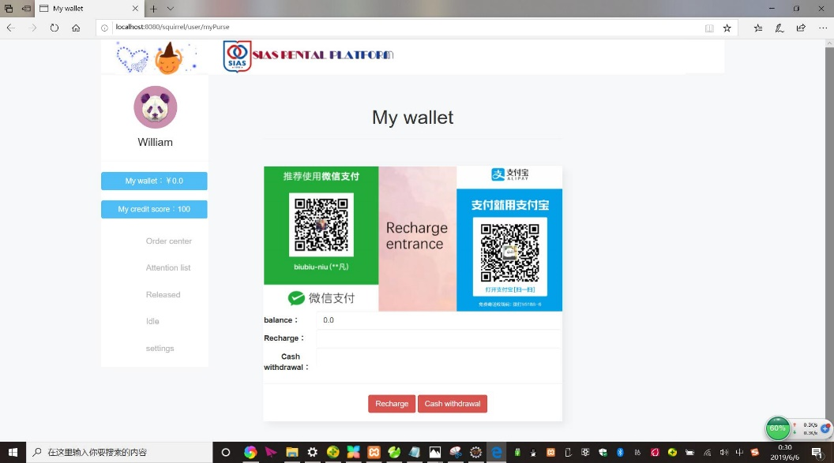
Orders Controller
Buyer process
What I am going to talk about is a simple operation process that includes the background control system of the user during the payment process.
The background helps the user to solve most of the tasks, which makes the user's operation the easiest. For example, the user only needs to simply click on the item and click on the settlement. Purchased successfully, the user only needs to click on the destination saved by himself, and the product can be automatically delivered to the target location through the background.

Slide 21
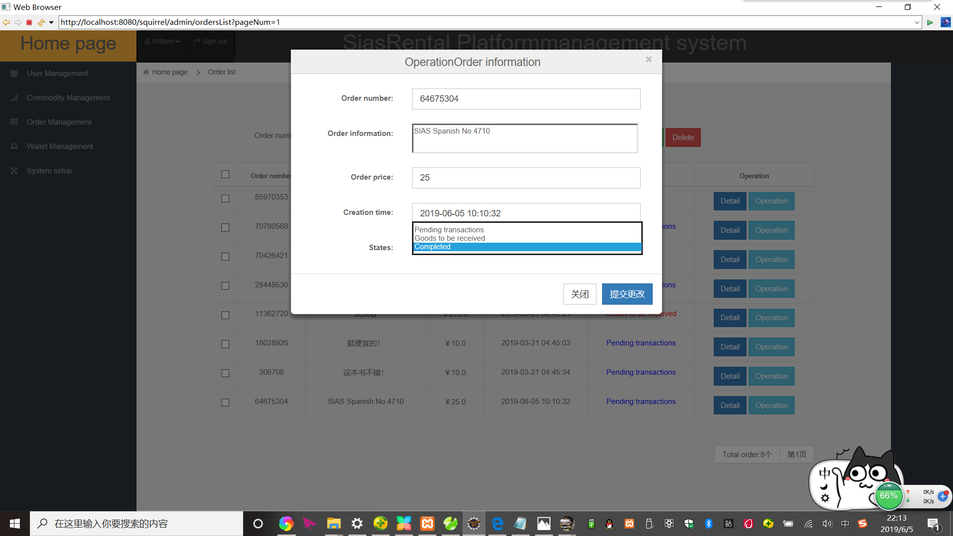
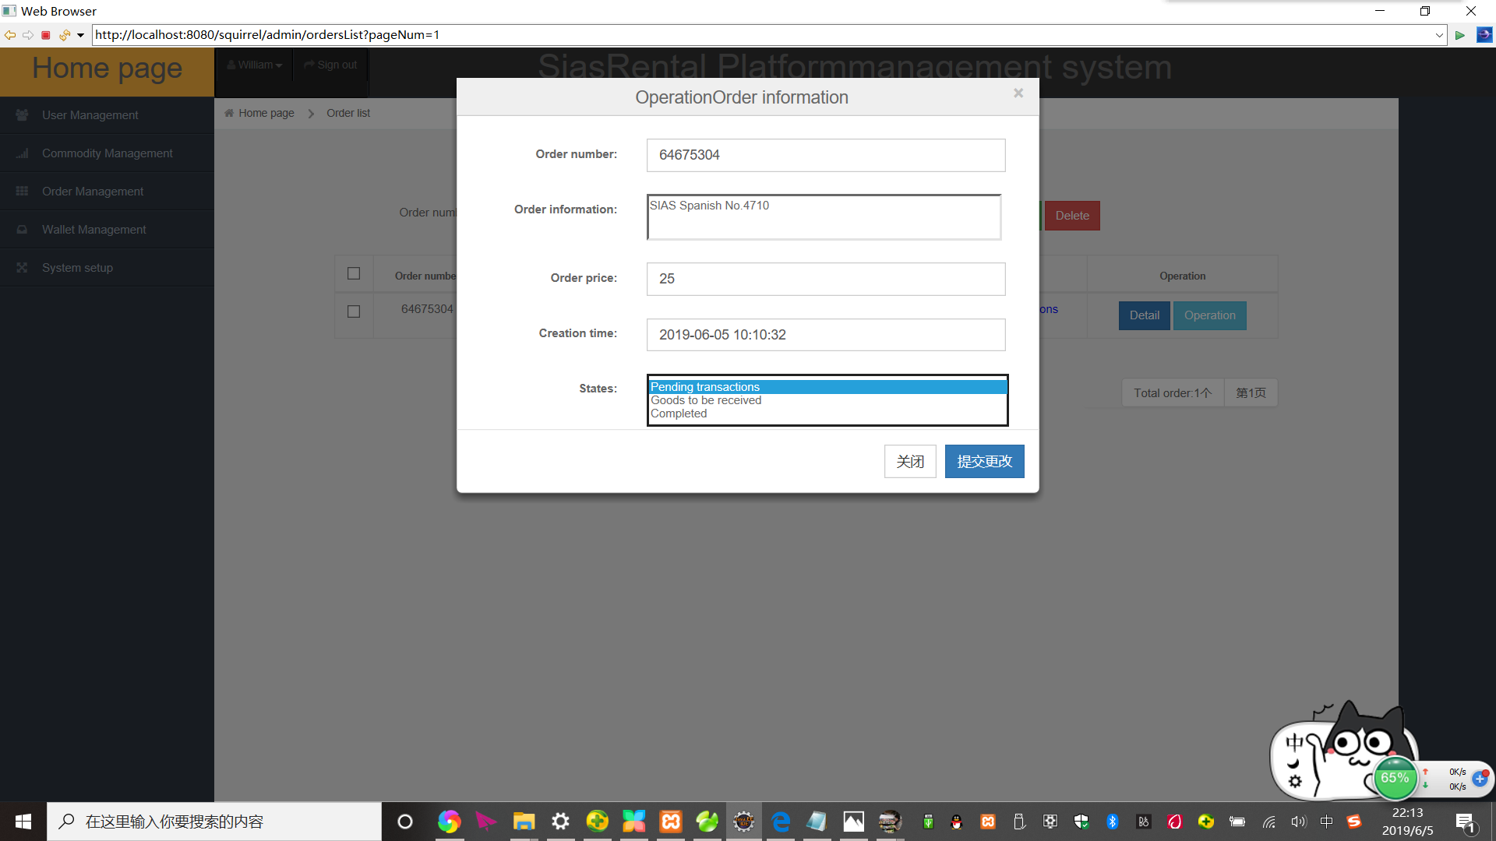
Seller collection process
Buyer process
The code on the left is the process of the seller collecting money.
This is when the purchaser confirms receipt of the goods, the money will be directly stored in the seller's online wallet, which will help simplify the seller's collection process, direct background operations to help sellers collect money, sellers can wait for their free time When viewing balance online

Slide 22
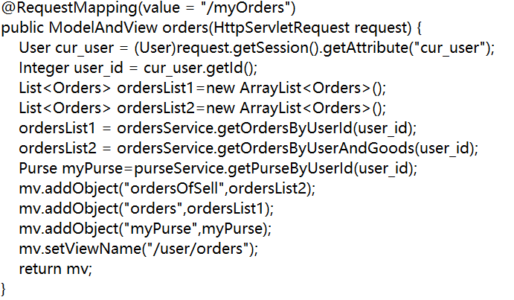
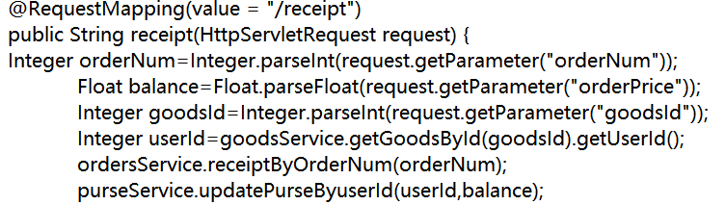
Buyer code
Seller code

Slide 23
Function: View order status
Guy

Slide 24
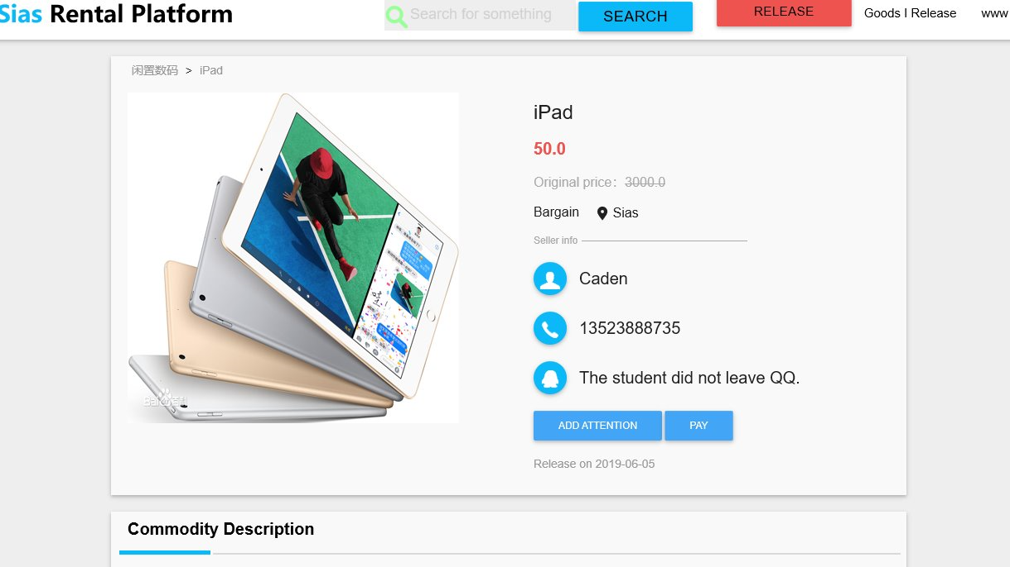
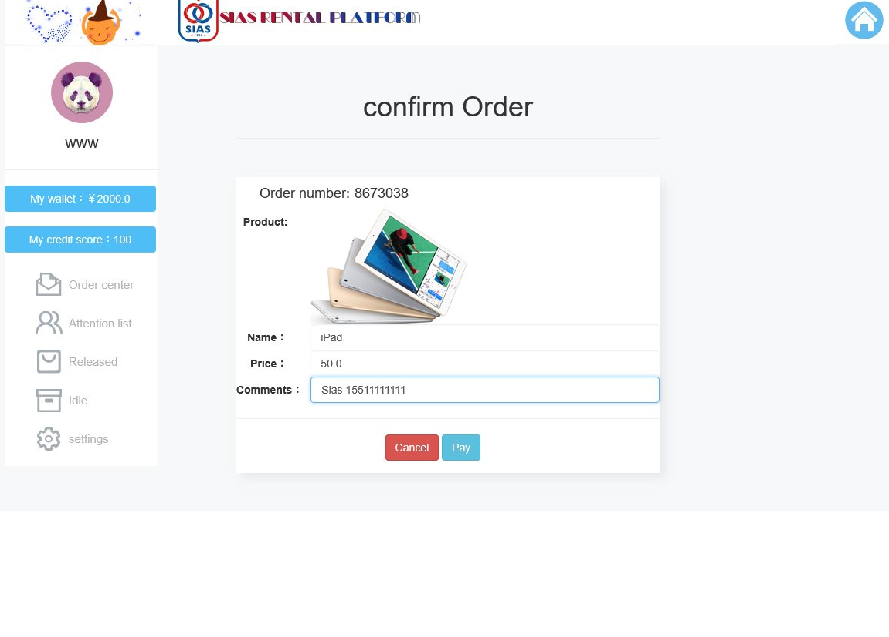
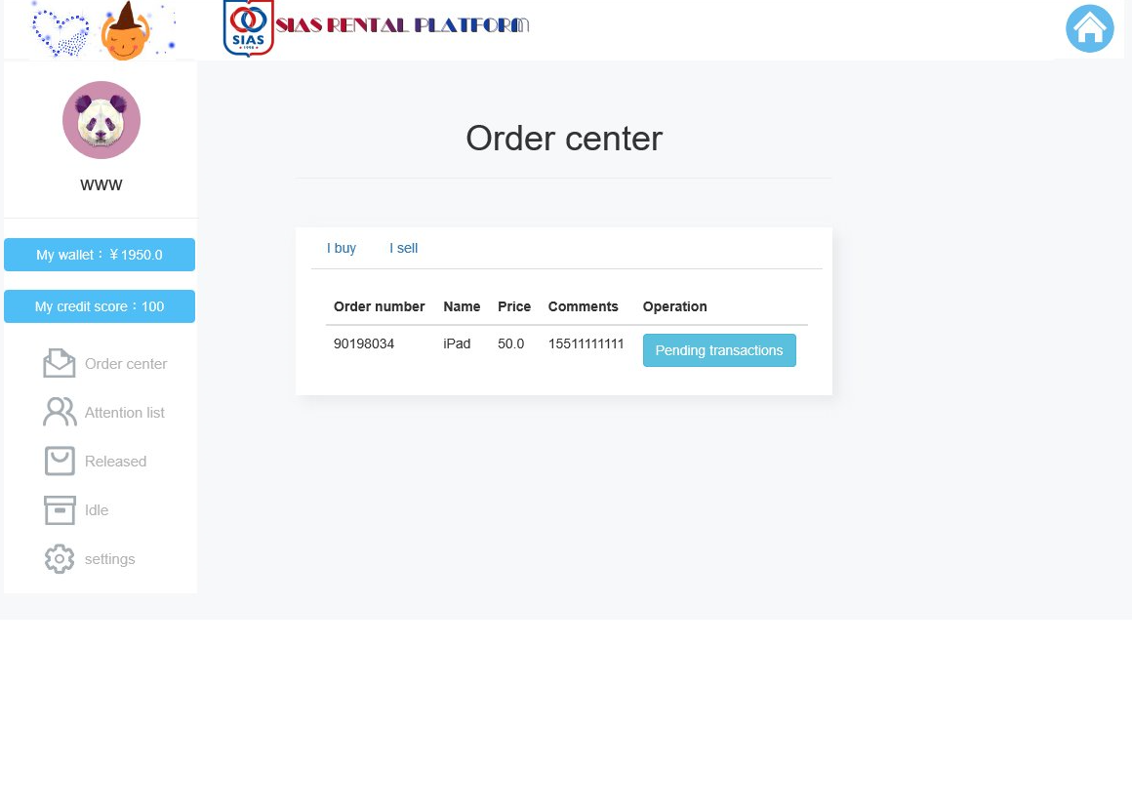
Function: View order status
1.Choose items to rent
2. Fill in personal address and personal information, and pay
3. Enter the order center to view the order information of the purchased goods

Slide 25
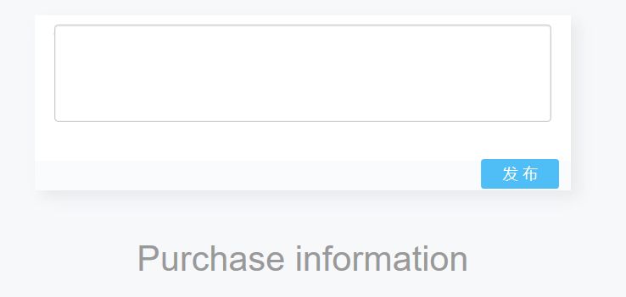
Function: comments
1. Enter the product details page
2. Enter the statement the user wants to express
3. Click on the comment to show that the comment was successful

Slide 26
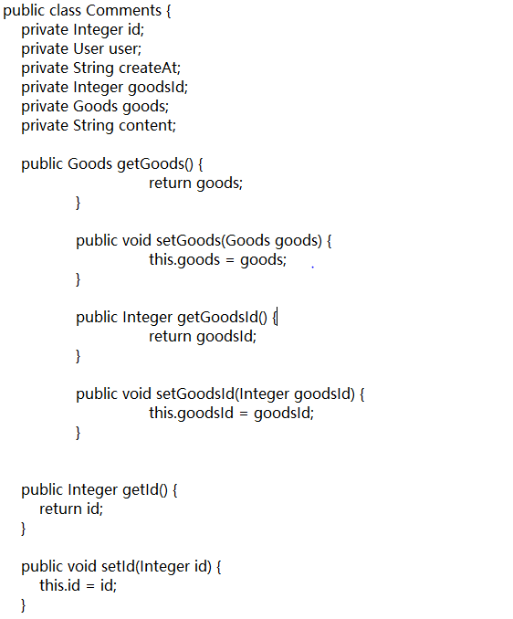
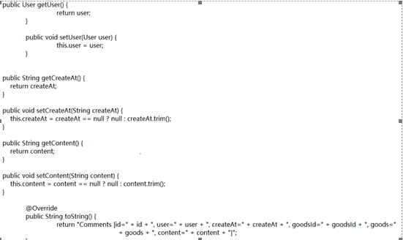

Slide 27
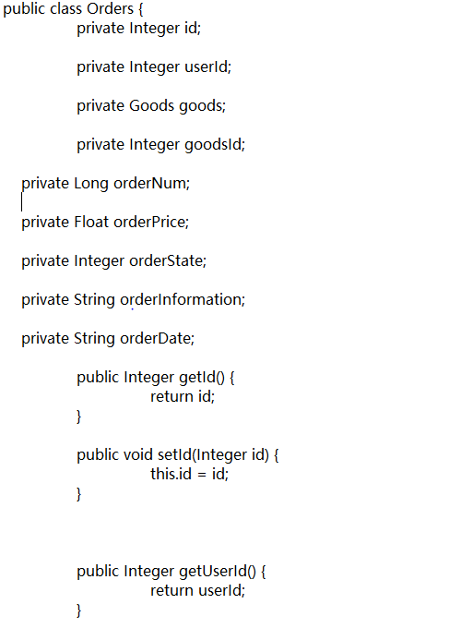
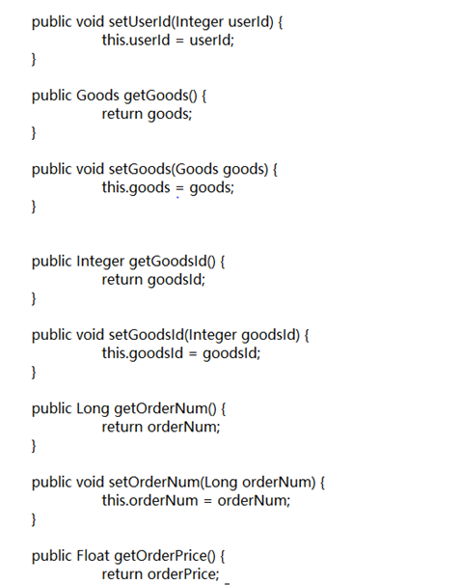

Slide 28
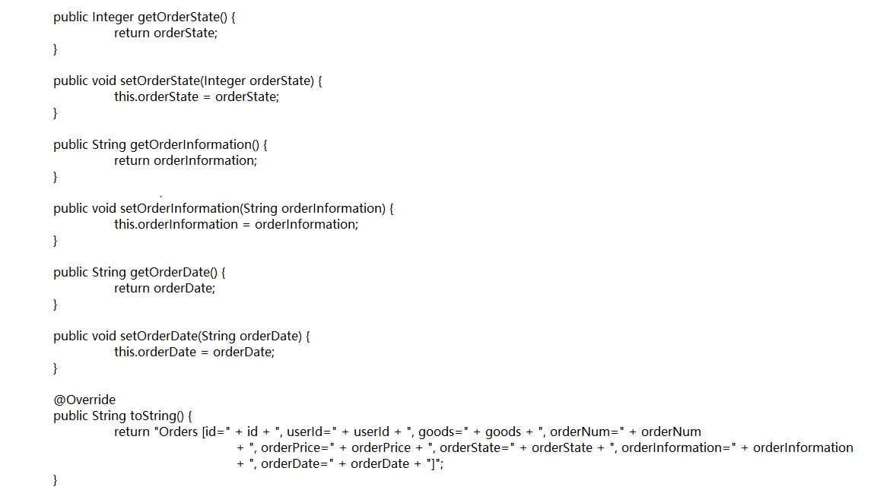

Slide 29
THANK YOU FOR YOUR WATCHING

